Slide 1



CAPSTONE PROJECT
Interactive Retail Sales & Performance Analysis in Power BI
Presented By
Student Name : Jharendra Jogi
College Name: Central Institute of technology kokrajhar
Department: Computer Science and engineering
Email ID:u22cse1074@cit.ac.in

Slide 2
OUTLINE:
Problem Statement
Proposed System/Solution
System Development Approach
Algorithm & Deployment
Result
Conclusion
Future Scope
References

Slide 3
Problem Statement:
The Challenge at Maven Market
In a competitive retail landscape, Maven Market — a multinational grocery chain with 24 stores across the USA, Canada, and Mexico — is drowning in fragmented data from sales, transactions, products, customers, stores, and returns.
Management faces critical blind spots as-:
Which products, brands, and stores truly drive revenue and profit?
Where are costly returns eroding margins the most?
How do customer behaviors, seasonal trends, and regional differences impact performance?
Are we hitting targets, or are hidden opportunities (and risks) going unnoticed?

Slide 4
Proposed Solution:
Data Integration
Combined multiple datasets including transactions, customers, products, stores, calendar, and returns.
Data Transformation
Cleaned and transformed data using Power Query Editor.
Data Modeling
Built relationships between tables to create an efficient star schema model.
KPI Calculation
Used DAX measures to calculate important metrics such as:
Total Revenue
Total Profit
Total Transactions
Return Rate
Profit Margin
Evaluation:
Accuracy of calculated KPIs, Clarity of visualizations, Ease of data exploration, Ability to identify trends and insights quickly.
Result :
The developed Maven Market Multi-Page Power BI Dashboard provides a comprehensive view of the company's business performance. It enables stakeholders to monitor sales trends, analyze customer behavior, evaluate store and product performance, and identify return patterns.

Slide 5
System Approach:
Hardware Requirements
Computer/Laptop with minimum 4 GB RAM
Intel i3/i5 or equivalent processor
Minimum 10 GB free storage space
Software Requirements
Microsoft Power BI Desktop
Windows Operating System
Microsoft Excel / CSV files for dataset storage
Libraries / Tools Required to Build the Model
Power BI Desktop
Power Query Editor
DAX (Data Analysis Expressions)
Data Modeling
Excel / CSV Dataset Files

Slide 6
Algorithm & Deployment:
Analytical Approach Selection Uses Business Intelligence techniques in Power BI to analyze retail data through data modeling, DAX-based calculations, and interactive visualizations to generate meaningful business insights.
Data Input Transactions / Sales Data, Orders Data, Customers Data, Products Data, Stores Data, Returns Data, Calendar Data
Processing & KPI Calculation
Data is cleaned and transformed using Power Query Editor
Relationships are created between tables to build a data model
DAX (Data Analysis Expressions) is used to calculate key KPIs
Visualization Process
Bar Charts
Line Charts
Maps
KPI Cards
Tables and Filters

Slide 7
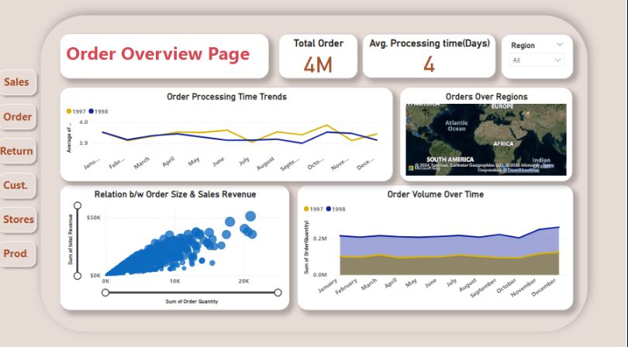
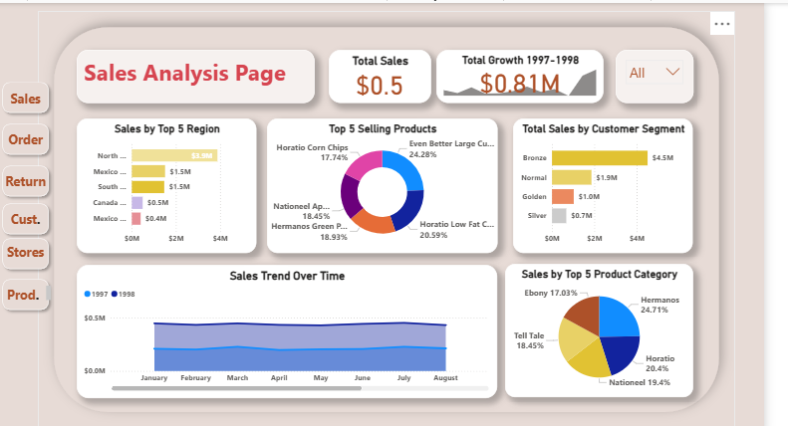
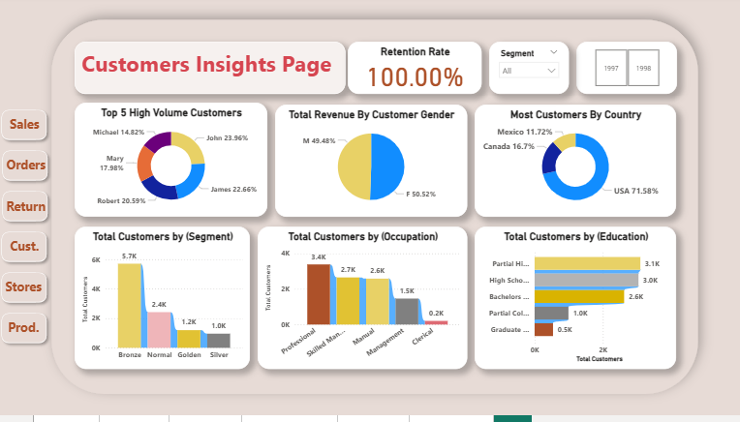
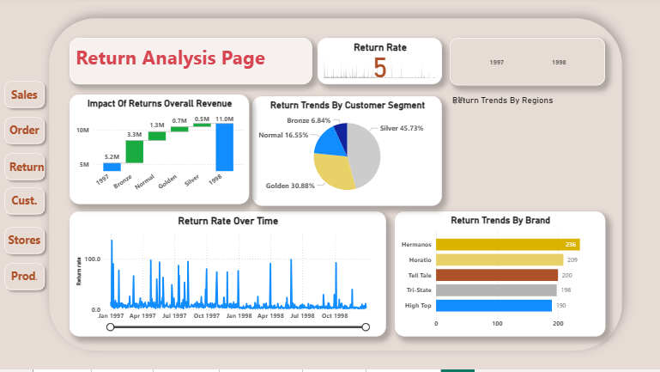
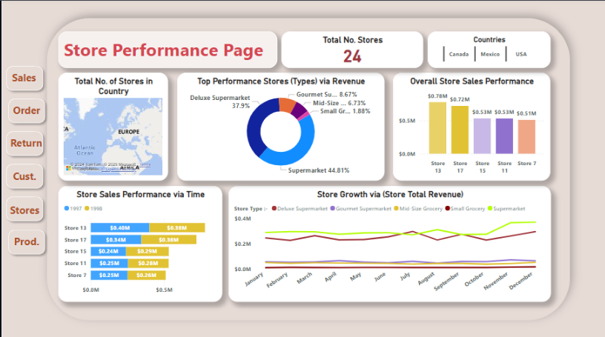
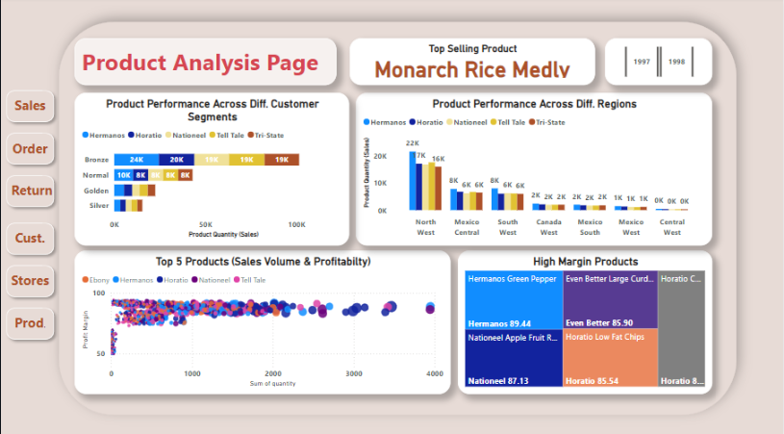
Result:

Slide 8
Conclusion:
Developed a multi-page Power BI dashboard to analyze Maven Market retail datasets and generate actionable business insights.
Integrated multiple data sources (sales, orders, customers, products, stores, and returns) using an optimized relational data model.
Applied Power Query transformations and DAX-based KPI.
Enabled interactive visualizations, filters, and drill-down
Addressed data cleaning, relationship modeling, and KPI calculation.

Slide 9
Future scope:
Integrate real-time data sources to enable live business performance monitoring and faster decision-making.
Expand the dashboard by incorporating additional datasets such as inventory, supply chain, and marketing data for deeper analysis.
Implement predictive analytics and machine learning models to forecast sales trends and customer demand.
Optimize the system using advanced data modeling and performance tuning for handling larger datasets.

Slide 10
References:
List and cite relevant sources, research papers, and articles that were instrumental in developing the proposed solution. This could include academic papers on bike demand prediction, machine learning algorithms, and best practices in data preprocessing and model evaluation.
GitHub Link: Link

Slide 11
Thank You

